Slide 1
SAP BTP Build Apps Training
Day 4
Anubhav Oberoy
www.AnubhavTrainings.com
Follow excellence with sheer passion

Slide 2


DISCLAIMER
The training content and delivery of this presentation is confidential, and cannot be recorded, or copied and distributed to any third party, without the written consent of Anubhav Trainings

Slide 3
Agenda – Day 4
01
Scanner App use case
02
JSON and APIs
03
Consume Web API

Slide 4

Use case 2
Persona:
Name: Priya
Age: 32
Role: A health-conscious mother of a 6-year-old boy
Goal: To ensure her son eats healthy snacks, avoiding high sugar, additives, or allergens
Scenario:
Priya is grocery shopping on a busy weekday afternoon. Her son loves trying new snacks, but Priya is always worried about hidden sugars, preservatives, and allergy-triggering ingredients. Reading tiny labels on packaging is time-consuming and frustrating.
Key Features of the App:
- Barcode scanning
- Instant nutrition info from Open Food Facts
- Allergen warnings
- Healthy alternatives
- Kid-focused nutritional grading
Benefit:
Priya saves time and makes informed decisions, ensuring her son enjoys tasty snacks without compromising health.

Slide 5











What is JSON – Java Script Object Notation
{
key: ‘value’,
key: ‘value’,
key: ‘value’
}
orderNo shipTo date
101 | SHIP1 | 20251212

Slide 6
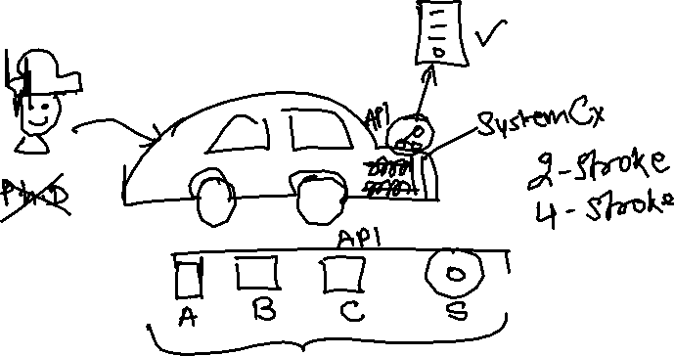
What is API?
API stands for application programming interface, it is a contract between our system and a system which is trying to connect with us.
API gives a contract between caller and called party
That makes integration possible w/o knowing internal functionality of system
Critical role in integration and exchange of data between systems
Servers as single entry point for different business objects (so,po,material)

Slide 7
Open APIs
Open Food Facts offers a comprehensive API that allows developers to access a vast database of food product information, including details such as ingredients, nutritional content, allergens, and labels. This open-source database is continually enriched by contributors worldwide, making it an invaluable resource for applications focused on health, diet tracking, food research, and consumer information. citeturn0search0
Key Features of the Open Food Facts API:
- Extensive Data Access: Retrieve detailed information about food products, including ingredients, nutritional facts, allergens, and more.
- Global Coverage: Access data from a wide range of products sourced from various countries, providing a diverse and comprehensive dataset.
- User Contributions: Benefit from a continually growing database, as users worldwide contribute by adding new products and updating existing information.
- Integration Flexibility: Utilize the RESTful API to seamlessly integrate food product data into mobile apps, research projects, software, or diet-based web services.
https://world.openfoodfacts.net/api/0/product/8904004400083?fields=product_name,nutriments,image_front_url
Sample products –
8901764061257
8901262200189
8901063029279
8904004400083

Slide 8
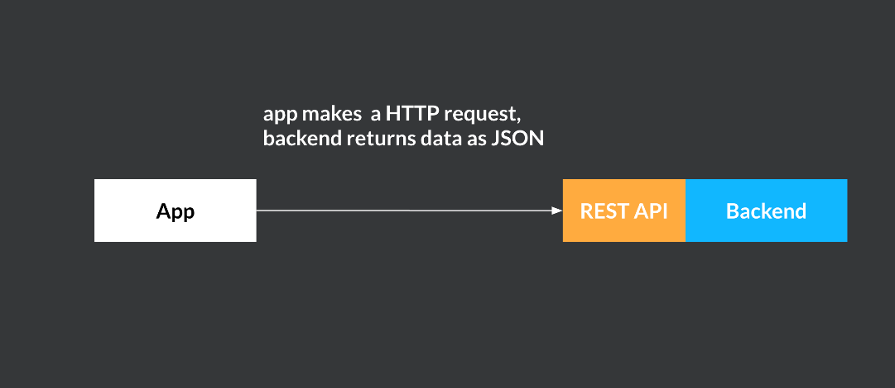
Build Apps – REST API integration
SAP Build Apps enables you to create applications on multiple platforms such as iOS, Android, and Web. Most apps need some way to store data when the app isn't running. The data can be stored on the device itself or in an external back end, accessible over the Internet. A common architecture for Internet services is a front end - back end model, in which an app acts as the front end handling user interactions, while a back end stores and processes data. As it's typical that a front end (or multiple front ends) will use a different technology stack from that of the back end, there needs to be an easy standard way to communicate between the two.

Slide 9
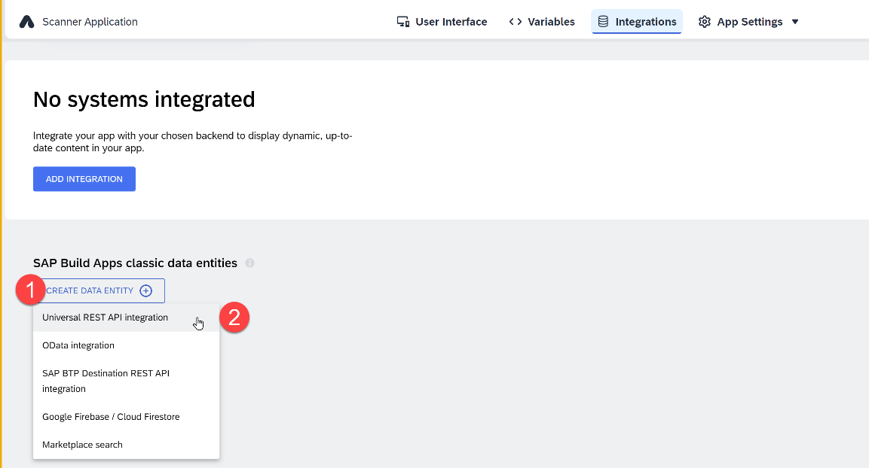
Integrations – REST API
A REST API direct integration type data resource essentially tells SAP Build Apps how a specific, JSON-format HTTP REST API can be accessed. It defines things like a base URL, headers, query parameters, available methods, schemas, and so on. You can create new external data resources and edit existing ones via the Data button in the top toolbar. The resource configuration is split into base configuration and method configurations for GET collection, GET record, POST, PUT/PATCH, and DELETE.

Slide 10
Parts
https://world.openfoodfacts.net/api/0/product/8901063029279?fields=product_name,nutriments,image_front_url

Slide 11
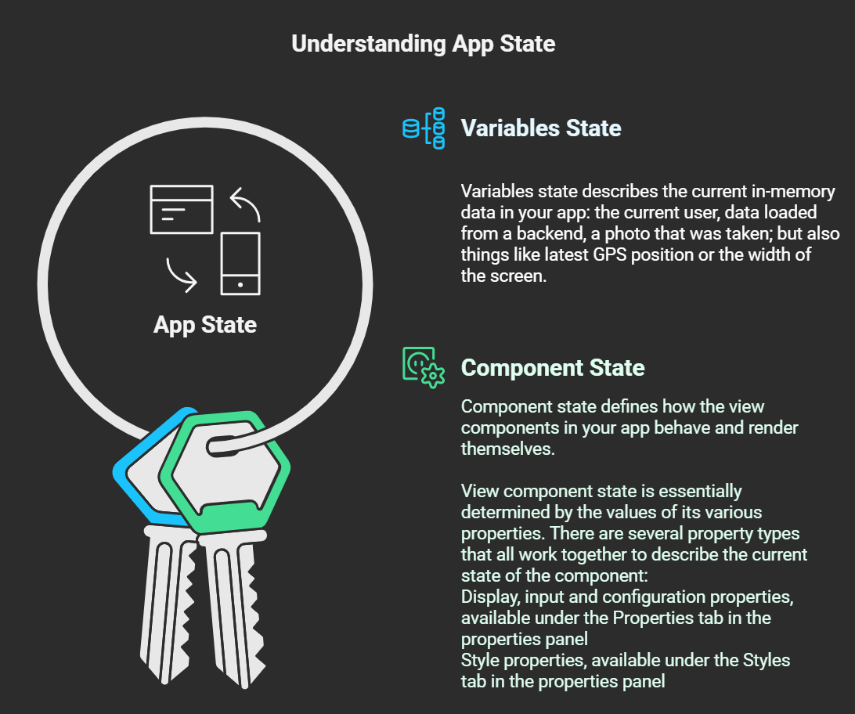
App State in SAP Build Apps
Every SAP Build Apps app that is running has what is called app state. It consists of two interlinked concepts: variables state and component state.

Slide 12
Types of Dynamic variables
Dynamic variables are the backbone of your app logic. For the most part, the data they contain at any given time is determined by what flow functions have been called during the app runtime so far.
Page variables
Page variables exist in the context of a single page. When a page is removed from the navigation stack, its page variables are reset.
Data variables
Data variables are like page variables, but their schema is defined by the data resource they are linked to. They also come with default logic that loads the associated data from the backend and stores it in the data variable.
App variables
App variables exist in the global context of the app. When the app opens for the first time, or is closed and reopened, app variables are reset.
Page Parameters
Page parameters can only be of the text type. Page parameters are read-only variables that can be set with the Open page flow function for the new page, e.g. ID of a product for a product details page.
Theme variables
Theme variables define how the various view components look, giving you an easy way to change the whole look-and-feel of your app.
System variables
System variables define properties of the current app and the device its running on. They cannot be affected by the user directly, but change when the underlying property changes.

Slide 13
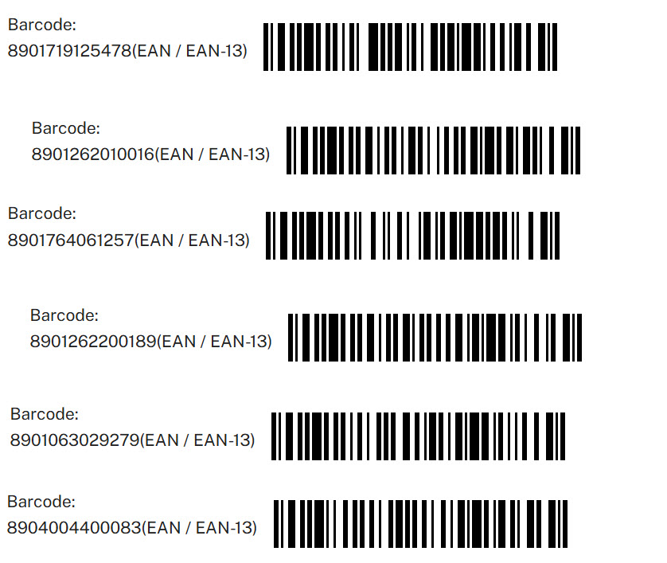
Test data

Slide 14
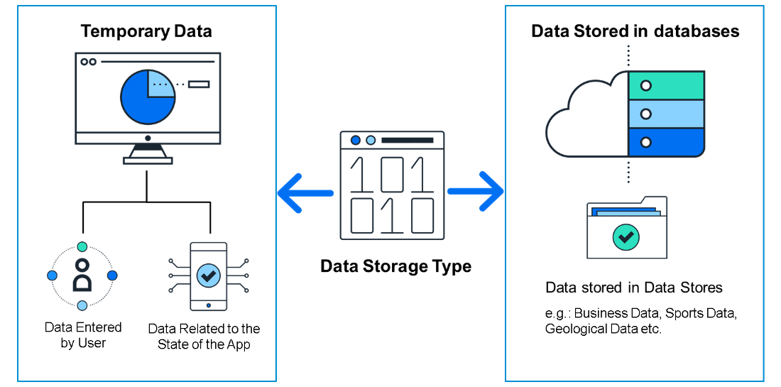
Data Resources in BTP
Applications live and die on their data, and without some form of data, an app wouldn’t be able to do much.
Some data is merely temporary and is stored while the app is running, such as:
Data entered by the user.
Data related to the state of the app; for example, while a user is playing a game, the app would need to store their score, name, and the current state of the board
Some data is stored in data stores or databases for use with other users, for example:
Business data, such as invoices and sales orders.
Sports data, such as teams and players and their statistics.
Geological data, such as earthquakes, their magnitude, and locations.

Slide 15
Types of Data Sources
There are different types of back-end systems from which you can retrieve data
SAP Build Apps lets you connect to the following:
OData Integration - This type of data resource lets you connect to OData services. OData services are services you reach with a URL and are designed for supplying business data. OData services conform to a rigid set of rules for defining the format of the URLs and of the returned data.
REST API Direct Integration - This type of data resource lets you connect to REST services. REST services do not need to conform to the same rigid rules for URLs and responses, as OData services do. This can make REST services require a little more work to understand, and to configure within SAP Build Apps.
On-Device Storage - This data resource actually creates a data store on the device the user is using, as opposed to REST and OData data resources, which connect to existing data stores. Such data is only stored on the current user’s device, so it is used for data needed only by the current user and that does not have to be shared.
Marketplace Data Resources - Marketplace data resources can be of any type. They are data resources that are defined and stored in the Marketplace and can be quickly installed from there. You may want to use the few data resources prebuilt for you, or you may want to create a data resource and be able to quickly reuse it in multiple projects.

Slide 16
Additional Data Resource types
There are some additional and important data resource types – especially for use in connecting to SAP back-ends – that depend on users being authenticated via SAP BTP
Visual Cloud Functions Integration - Visual Cloud Functions lets you easily create your own data store, not just connect to an existing one, and let multiple apps access it and let you share the data among many users.
OData Integration with BTP Destination - OData with a BTP destination is the same as without except that the URL and authentication is defined by an SAP BTP destination.
REST Integration with BTP Destinations - REST with a BTP destination is the same as without except that the URL and authentication is defined by an SAP BTP destination.

Slide 17
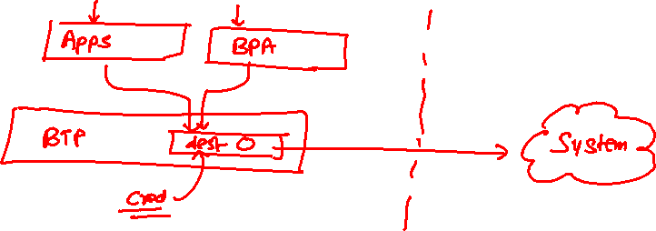
What is Destination in BTP
SAP BTP Destination is a configuration object within SAP Business Technology Platform (BTP) that allows applications to connect to external systems or services in a secure and managed way.
These destinations store connection settings like URLs, authentication, and proxy settings, enabling seamless communication between your BTP applications (like those running on SAP CAP, UI5, or Fiori) and other systems (such as on-premise SAP systems, third-party APIs, or cloud services).

Slide 18
Create destination to simple OData Service
Type=HTTP
HTML5.DynamicDestination=true
Authentication=NoAuthentication
Name=AnubhavOData
WebIDEEnabled=true
sap.processautomation.enabled=true
sap.build.usage=odata_gen
ProxyType=Internet
URL=https://orderscapapp.cfapps.eu10.hana.ondemand.com/service/OrderManagement
Appgyver.Enabled=true
sap.applicationdevelopment.actions.enabled=true
Images:
https://ui5.sap.com/test-resources/sap/m/demokit/cart/webapp/localService/mockdata/images/HT-1020.jpg

Slide 19

What We Did
Let’s Summarize

Slide 20

www.anubhavtrainings.com
Thank You
End of Day 4

Slide 21


We’re committed to empower you to be
#FutureReady
through powerful training solutions.
We build the workforce of the future.
250+
Corporate Clients
30,000+
Learners Trained
25000+
Learners Placed
FREE WEBINARS
Sign up for free webinars with industry experts every fortnight!
Enroll Now!
Contact us today!
https://anubhavtrainings.com

